Slide 1


Dr Sam Thompson
October 2023

Slide 2

Outline
Executive Summary
Introduction
Methodology
Results
Conclusion
Appendix

Slide 3

Executive Summary
Data collected from SpaceX API and web-scraped from Wikipedia
Data wrangled and encoded for ML
EDA performed with visualization and SQL
Increase in success from 2017 to 2020, best success in ES-L1, GEO, HEO, and SSO orbit types
Folium
Locations of most successful sites and proximities to landmarks
Dashboard
Success rates of each launch site, most successful being CCAFS SLC-40
ML
SVM and KNN produce best predictive result of all algorithms, ~84% accuracte

Slide 4
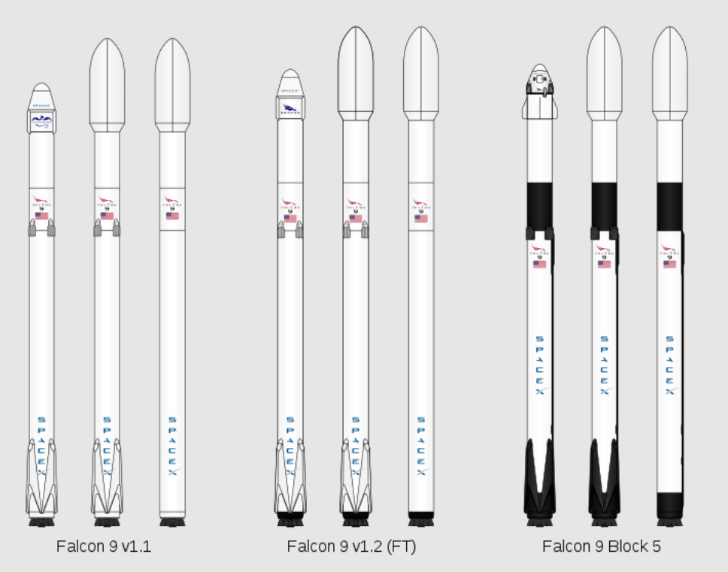
Introduction
Working for Space Y, the leading competitor to Space X, we need to understand how our rivals successes can benefit us and lead to greater market share in the reusable rocket race
Space X’s Falcon 9 rocket, their flagship vessel, has a reusable first stage. The first stage serves as the main thruster out of the atmosphere, and is extremely costly to build from scratch for each launch
In this report we’ll look at the cost of each launch, and the probability of being able to reuse the first stage of our rocket in a later trial. To do this, we’ll use existing open-access data from Space X.

Slide 5

Section 1

Slide 6








Methodology
Data collection
The data was collected directly from Space X using the Space X REST API, api.spacexdata.com/v4/. A comparison was also made using webscraping with BeautifulSoup
Perform data wrangling
Perform exploratory data analysis (EDA) using visualization and SQL
Perform interactive visual analytics using Folium and Plotly Dash
Perform predictive analysis
Classification models were used to build our predictive capability.
Data was cleaned and processed using Pandas and Numpy

Slide 7
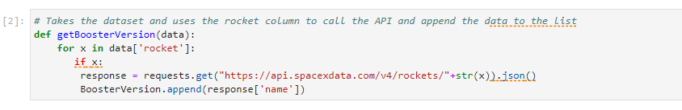
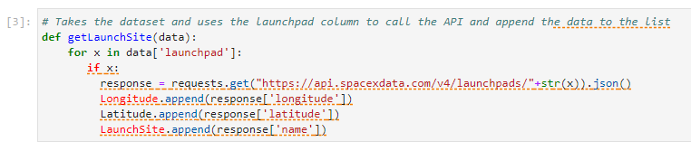
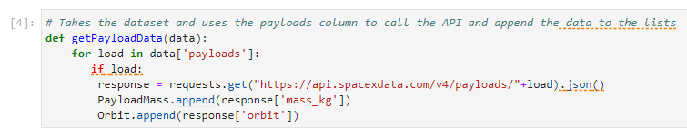
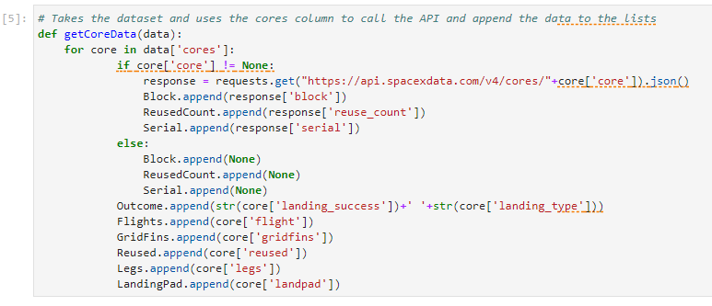
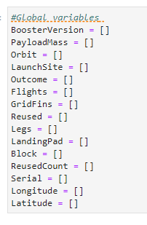
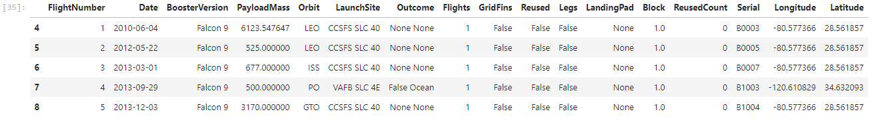
*Data url: https://cf-courses-data.s3.us.cloud-object-storage.appdomain.cloud/IBM-DS0321EN-SkillsNetwork/datasets/API_call_spacex_api.json
Data Collection – SpaceX API
Data pulled from SpaceX REST API
1) requests.get(url*)
2) pd.json_normalize
Retrieve the JSON file via the API and convert to pandas dataframe
3) Create subset of dataframe containing only 15 relevant columns of
4) Use specific requests.get() functions to fill columns
5) Isolate only rows for Falcon 9 boosters
6) Convert nulls in Payload to mean for column
GITHUB: IBMDataScienceCapstone/jupyter-labs-spacex-data-collection-api.ipynb at main · SpongeSJT/IBMDataScienceCapstone (github.com)

Slide 8
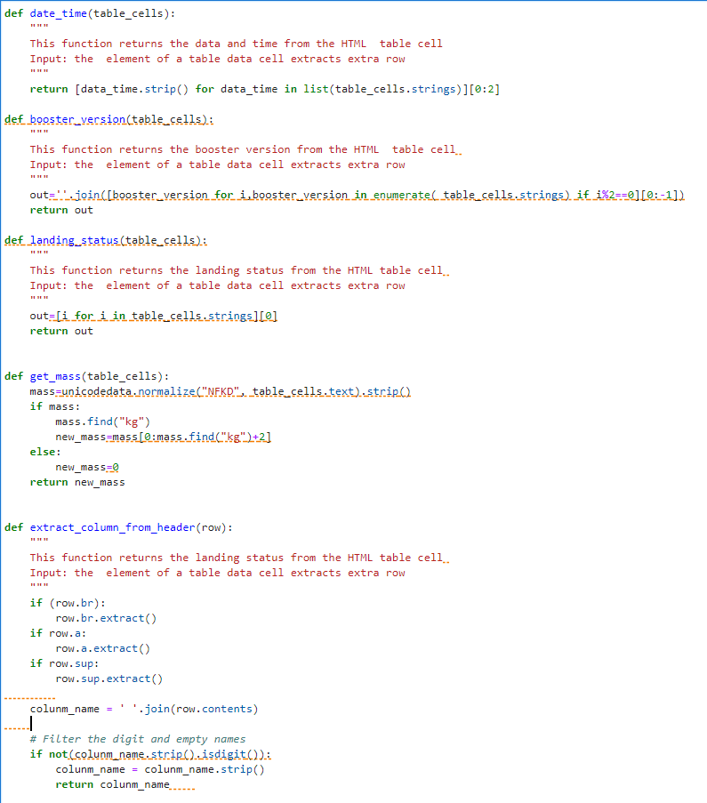
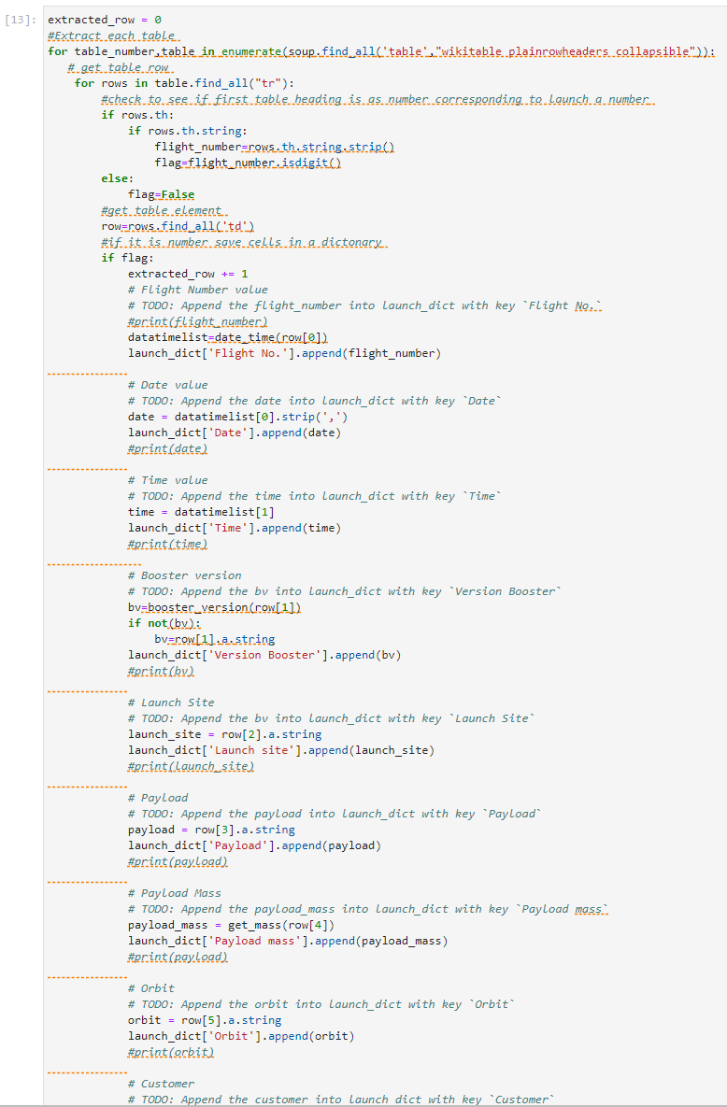
*Data url: https://en.wikipedia.org/w/index.php?title=List_of_Falcon_9_and_Falcon_Heavy_launches&oldid=1027686922
Data Collection - Scraping
Comparison made with webscraping from Wikipedia table. BeautifulSoup and Pandas used to make data useable
1) requests.get(url*)
2) BeautifulSoup(url.content, htmlparser)
Retrieve the data file via the API and convert to BeautifulSoup html object
3) Extract all table objects from html data BeautifulSoup.bs.findall(table)
4) For loop to extract all column names ,<th>, from html data and create dictionaries with column names
5) Loop through html data to extract values for columns and add to the dictionaries
Convert filled dictionary to a pd.DataFrame object and save as a CSV
GITHUB: IBMDataScienceCapstone/jupyter-labs-webscraping.ipynb at main · SpongeSJT/IBMDataScienceCapstone (github.com)

Slide 9
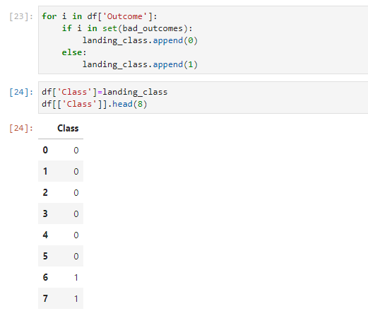
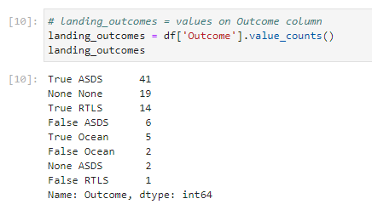
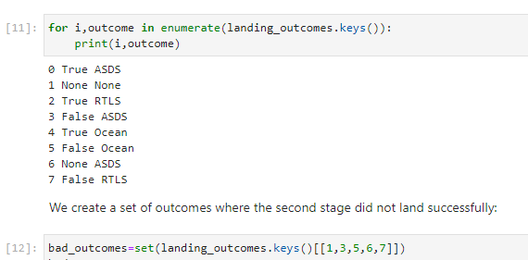
Data Wrangling
The data were explored, using value counts and date type investigations on LaunchSite, Orbit, and Outcome columns
A dictionary was created for the Outcome column, to isolate each type of outcome
The column converted the types of landing to either 1 for success (True), or 0 for failure (False)
Feature engineering was also performed on the columns "Orbit", "LaunchSite", "LandingPad", "Serial”, with “one hot encoding” used to prepare the data for Machine Learning
GITHUB: IBMDataScienceCapstone/labs-jupyter-spacex-data_wrangling_jupyterlite.jupyterlite.ipynb at main · SpongeSJT/IBMDataScienceCapstone (github.com)

Slide 10
EDA with Data Visualization
Charts plotted
Flight number vs Launch Site, Scatter plot. Allowed us to see trend of how many launches were performed per site and when they were done in the sequence of launches
Payload Mass vs Launch Site, Scatter plot. Allowed visualization of trend between payload mass and launch site
Orbit Type vs Success Rate, Bar plot. Allowed visualization of success rate of launches vs their desired orbit
Flight Number vs Orbit type, Scatter plot. Allowed visualization of changes in orbit type during the sequence of launches
Payload vs Orbit type, Scatter plot. Allowed visualization of different payload masses and their desired orbit
Yearly Success rate change, Line plot. Showing how success of launches changed over time
GITHUB: IBMDataScienceCapstone/vizeda.ipynb at main · SpongeSJT/IBMDataScienceCapstone (github.com)

Slide 11
EDA with SQL
SQL Queries:
Display unique launch site names
Display sites containing string ‘CCA’
Display sum of payload masses launched in the table
Display average payload mass in the table
List the date when the first successful landing outcome in ground pad was achieved
List the names of the boosters which have success in drone ship and have payload mass greater than 4000 but less than 6000
List the total number of successful and failure mission outcomes
List the names of the booster_versions which have carried the maximum payload mass
List the records which will display the month names, failure landing_outcomes in drone ship ,booster versions, launch_site for the months in year 2015
Rank the count of landing outcomes (such as Failure (drone ship) or Success (ground pad)) between the date 2010-06-04 and 2017-03-20, in descending order
GITHUB: IBMDataScienceCapstone/sqleda.ipynb at main · SpongeSJT/IBMDataScienceCapstone (github.com)

Slide 12
Build an Interactive Map with Folium
Explain why you added those objects
Add the GitHub URL of your completed interactive map with Folium map, as an external reference and peer-review purpose
Created a map of the SpaceX launch sites
Added map markers to show their locations
Added circles to show the number of launches per site
Added lines to show the nearest city, the nearest railroad, and the nearest highway
GITHUB: IBMDataScienceCapstone/lab_jupyter_launch_site_location.jupyterlite.ipynb at main · SpongeSJT/IBMDataScienceCapstone (github.com)

Slide 13
Build a Dashboard with Plotly Dash
A Plotly Dashboard was created with pie charts and scatter plots
The pie charts were plotted to show the number of successful landings across the different launch sites
The pie chart could show all of the launch sites and their share of the total successes, or the success rate of a single site
The scatter plot was made to show the relationship between payload mass, booster version, and whether or not the landing was successful
The scatter plot was controllable by a payload mass slider to isolate regions of interest in the data space
GITHUB: IBMDataScienceCapstone/dash.txt at main · SpongeSJT/IBMDataScienceCapstone (github.com)

Slide 14
Predictive Analysis (Classification)
Four machine learning algorithms were explored
K Nearest Neighbors
Logistic Regression
Support Vector Machine (SVM)
Decision Tree
Data split into X and Y, and test train split. X was transformed with a standard scaler prior to test train splitting
Model was trained on a training set of the data comprising of 80% of the original dataset
GridSearchCV was used to tune the model hyperparameters
Accuracy on training set was returned, then accuracy on the testing set. A confusion matrix was then plotted
K Nearest Neighbors and SVM returned the highest accuracy
Data split into X and Y, X transformed with standardscalar
Model fit with training set and GridSearchCV performed to find hyperparameters
Accuracy Score retrieved on training set
Accuracy Score retrieved on test set
Confusion matrix plotted to test overall performance of algorithm
GITHUB: IBMDataScienceCapstone/SpaceX_Machine_Learning_Prediction_Part_5.jupyterlite (1).ipynb at main · SpongeSJT/IBMDataScienceCapstone (github.com)

Slide 15

Section 2

Slide 16
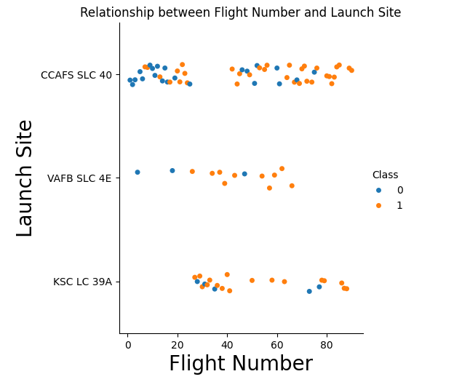
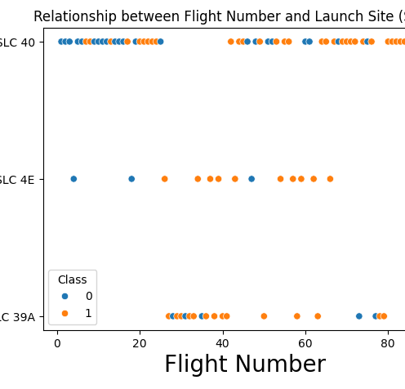
Flight Number vs. Launch Site
These plots show us the number of launches per site over the span of the project
We can see when in sequence sites were most active
We can get a sense of success rate by class, 1= success, 0 = failure

Slide 17
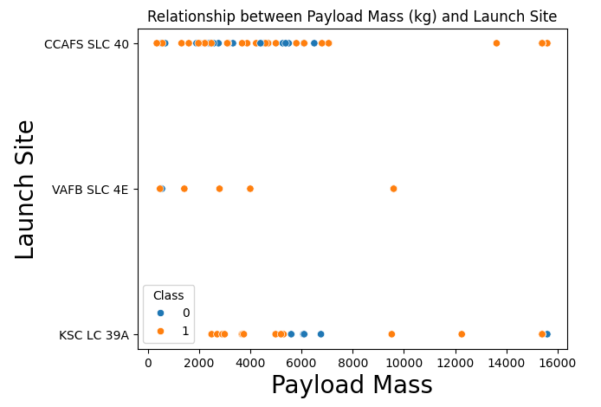
Payload vs. Launch Site
This plot shows us the number of launches per site with a given payload mass
We can see the distribution of weights launched and see any preference between site and payload mass. Highest masses are reserved for KSC and CCAFS sites.
We can get a sense of success rate by class, 1= success, 0 = failure

Slide 18
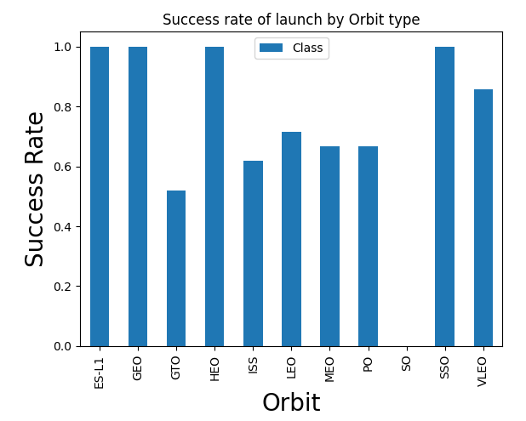
Success Rate vs. Orbit Type
This plot shows us the success rate by Orbit type
We can see that the most successful launch types are ES-L1, GEO, HEO, and SSO.
Least successful being SO, GTO, and ISS
No information about the distribution of sites and orbit type

Slide 19
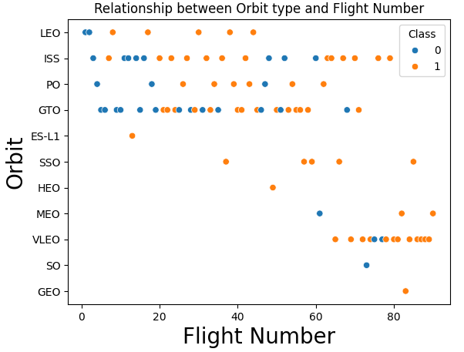
Flight Number vs. Orbit Type
We can see the distribution of orbit types over the span of the data
We see consistent launches in LEO, ISS, PO, and GTO
GEO, SO, VLEO, MEO only occur later
Success driven by more experience?

Slide 20
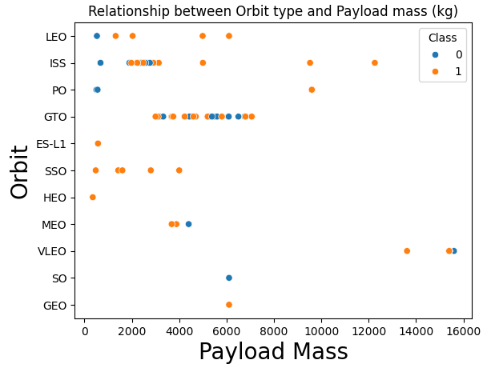
Payload vs. Orbit Type
We see overall a preference of <7000kg Payload mass
GTO has a narrow band of launches between 2000 and 8000 kg
Smallest ranges are in MEO
Largest range in ISS

Slide 21
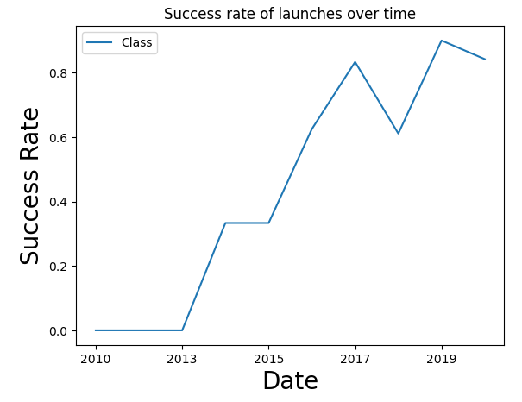
Launch Success Yearly Trend
We see a steady increase in success rate with a slight dip towards 2020
This could be due to fewer launches in the latter years of the dataset

Slide 22
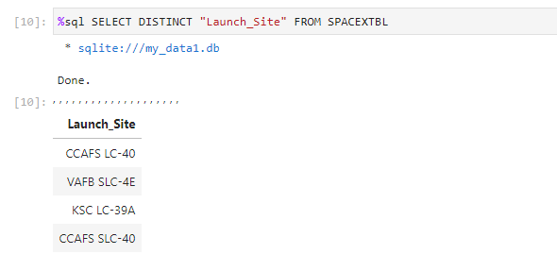
All Launch Site Names
Find the names of the unique launch sites
We see the list of 4 launch sites

Slide 23
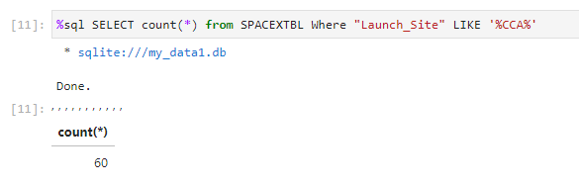
Launch Site Names Begin with 'CCA'
Find 5 records where launch sites begin with `CCA`
We see that there are 60 launches from sites beginning with CCA

Slide 24
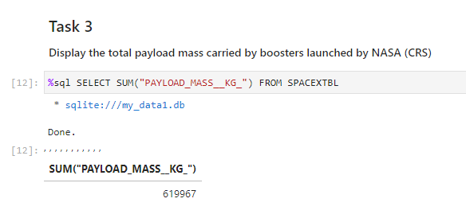
Total Payload Mass
Calculate the total payload carried by boosters from NASA
The total sum of the payloads is displayed here as 619967 kg

Slide 25
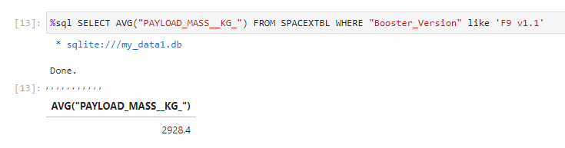
Average Payload Mass by F9 v1.1
Calculate the average payload mass carried by booster version F9 v1.1
We see the average mass carried is 2928.4 kg

Slide 26
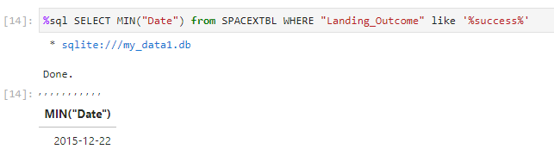
First Successful Ground Landing Date
Find the dates of the first successful landing outcome on ground pad
The earliest success in our data set was on the 22nd of December 2015

Slide 27
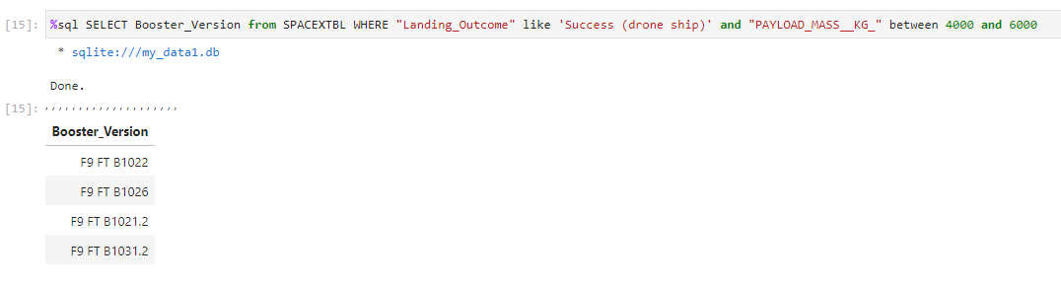
Successful Drone Ship Landing with Payload between 4000 and 6000
List the names of boosters which have successfully landed on drone ship and had payload mass greater than 4000 but less than 6000
We see that only F9 FT boosters have carried weights between 4000 and 6000 kg

Slide 28
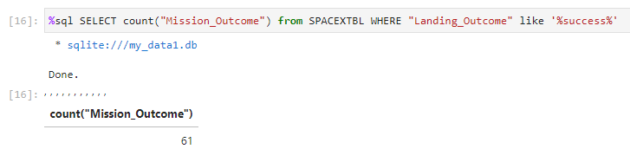
Total Number of Successful and Failure Mission Outcomes
Calculate the total number of successful and failure mission outcomes
We see here there have been 61 total successes

Slide 29
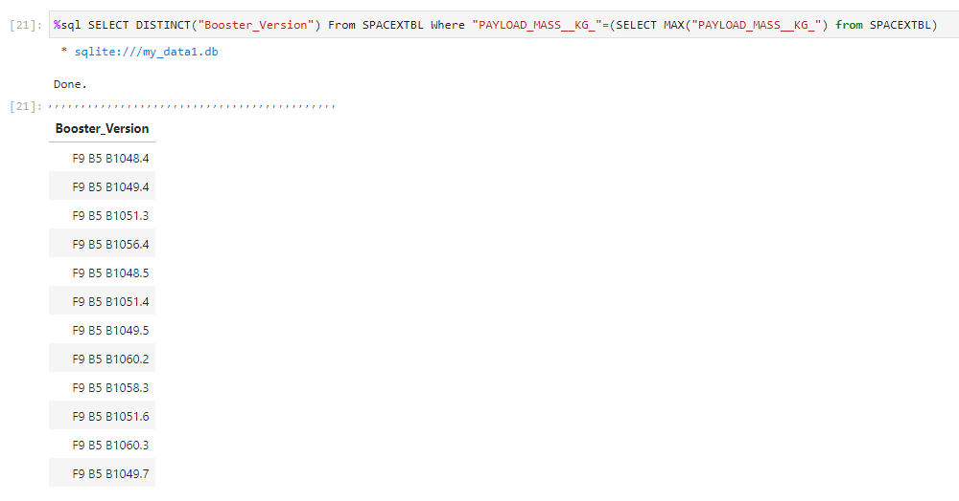
Boosters Carried Maximum Payload
List the names of the booster which have carried the maximum payload mass
We see only the F9 B5 boosters have carried the maximum payload

Slide 30
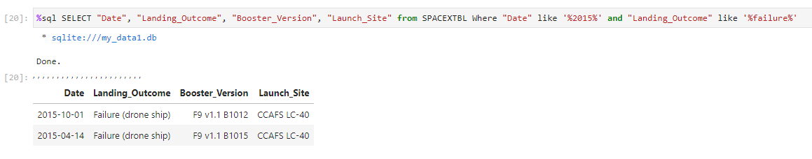
2015 Launch Records
List the failed landing_outcomes in drone ship, their booster versions, and launch site names for in year 2015

Slide 31
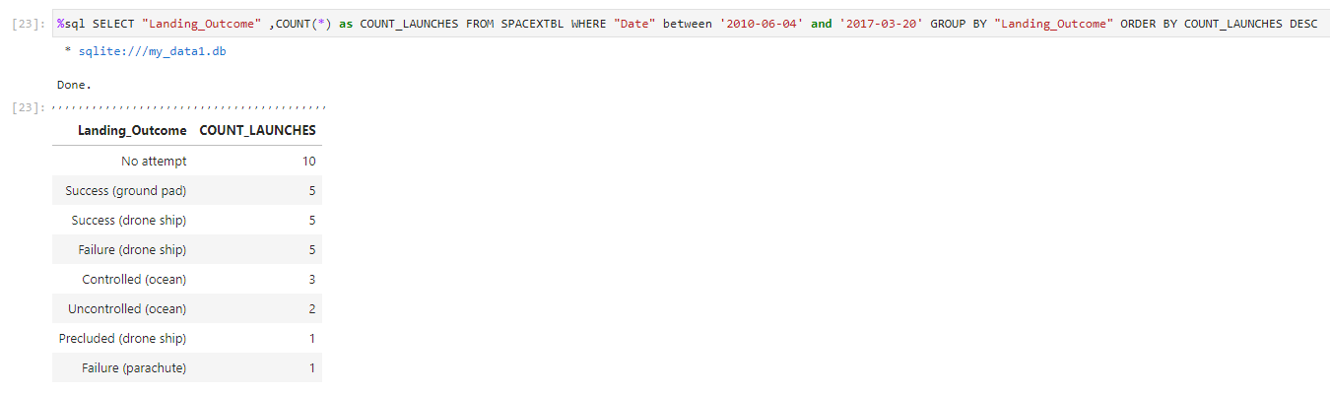
Rank Landing Outcomes Between 2010-06-04 and 2017-03-20
Rank the count of landing outcomes (such as Failure (drone ship) or Success (ground pad)) between the date 2010-06-04 and 2017-03-20, in descending order
The most prevalent result is no attempt, with a 3 way split on 2nd place for success (ground pad), success (drone ship), and failure (drone ship)

Slide 32

Section 3

Slide 33
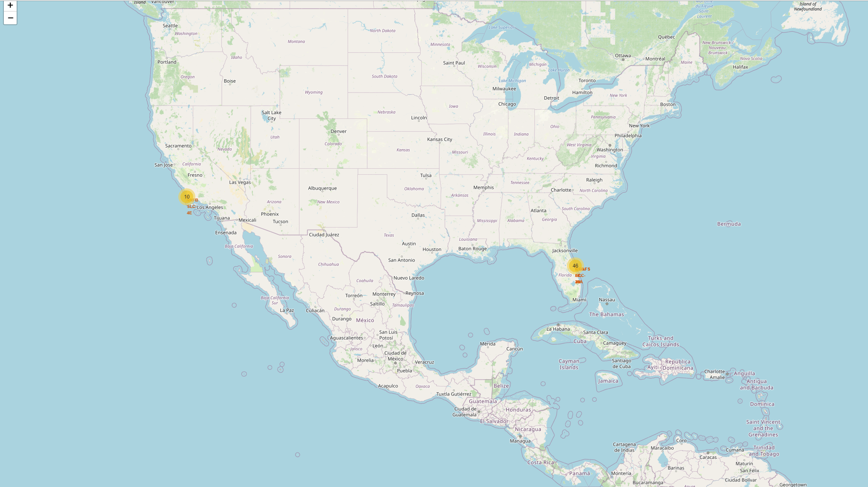
Launch site locations map
We see the launch locations on the map
They are based on the coast of Florida and California
California was likely chosen for existing infrastructure and ease of hiring top engineering talent near the silicon valley area
Florida likewise has a lot of existing infrastructure, and close ties for NASA. More launches were performed here than California

Slide 34
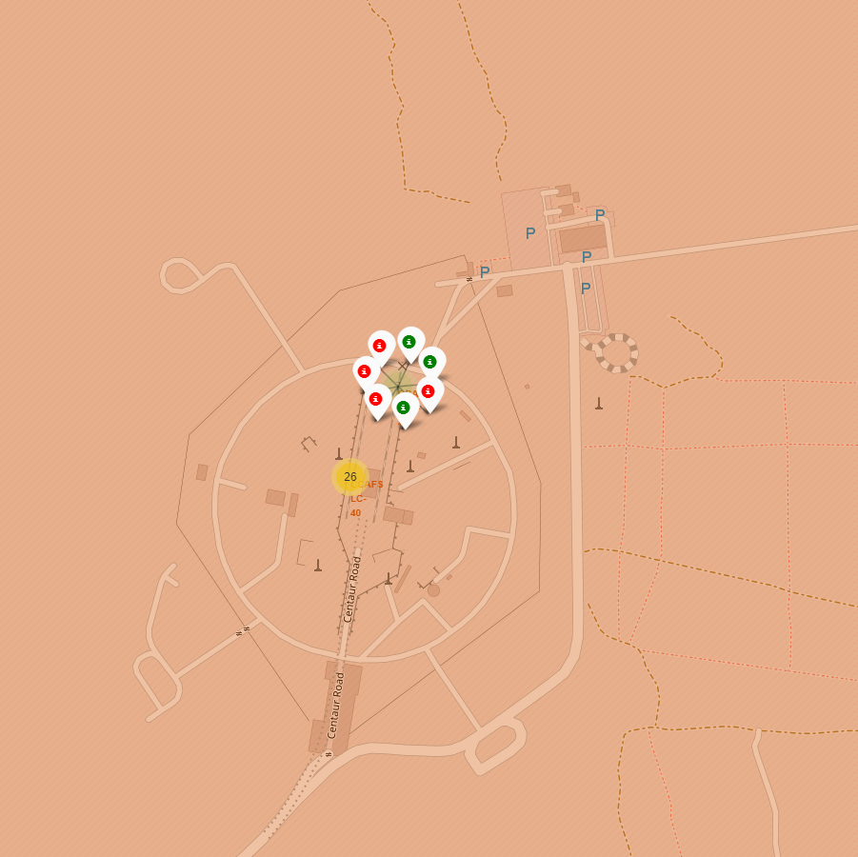
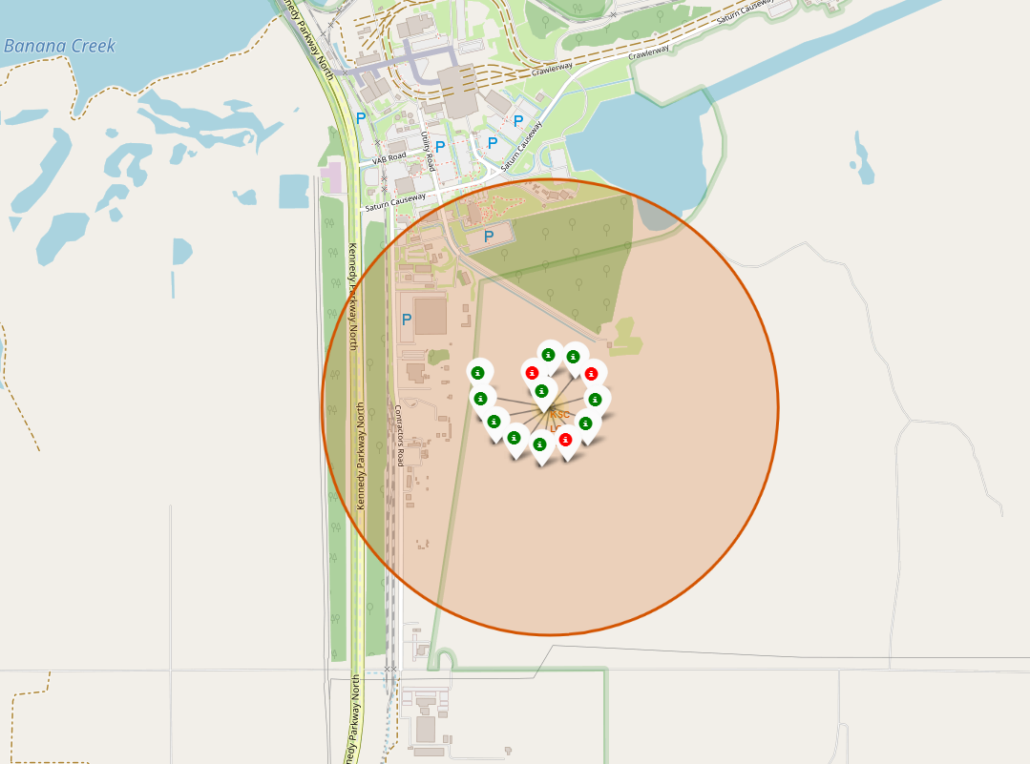
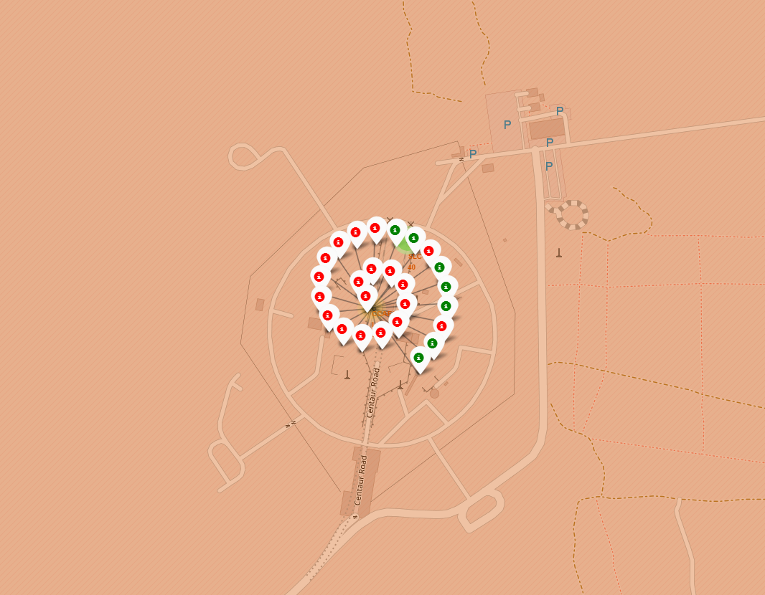
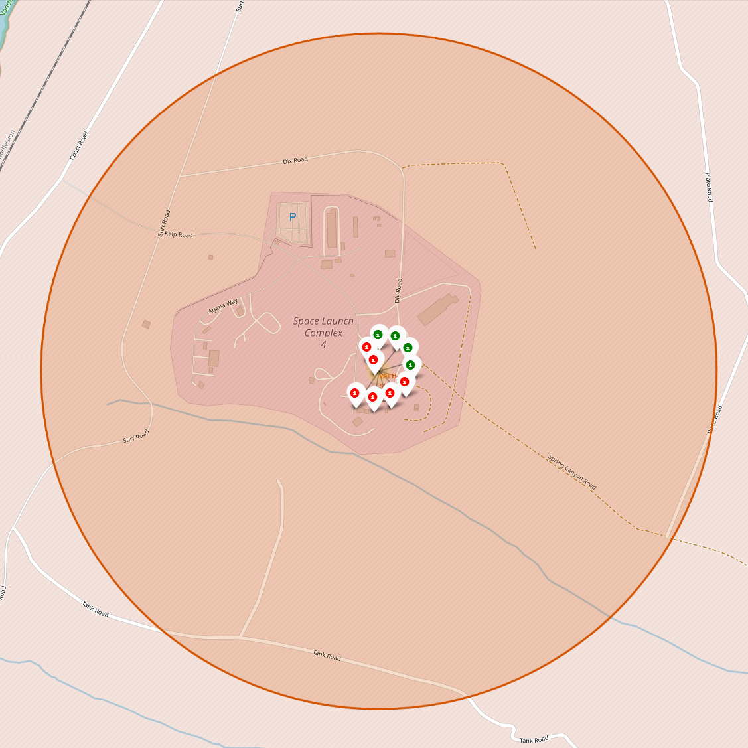
Success and number per site
We see the number of launches per site as a spiral of markers per site
Red is failure, green is success

Slide 35
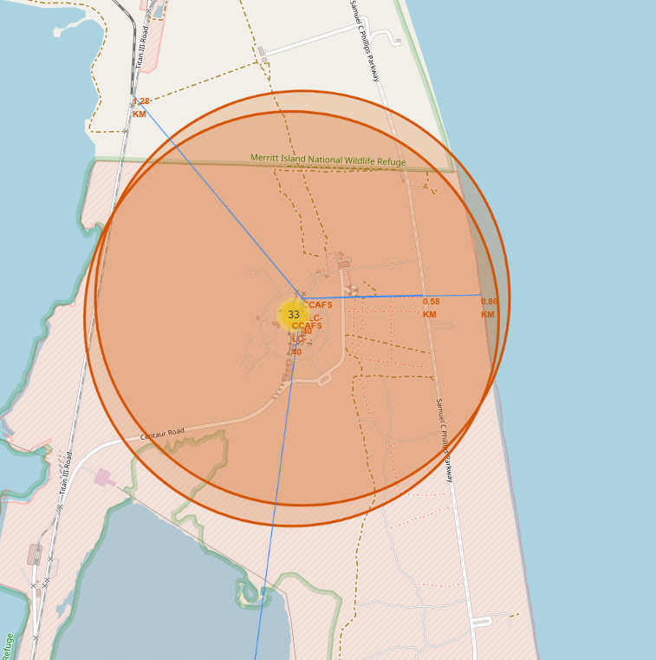
Launch site proximity to landmarks
Map showing proximity of nearest railway, highway, and coastline to the launch site

Slide 36

Section 4

Slide 37
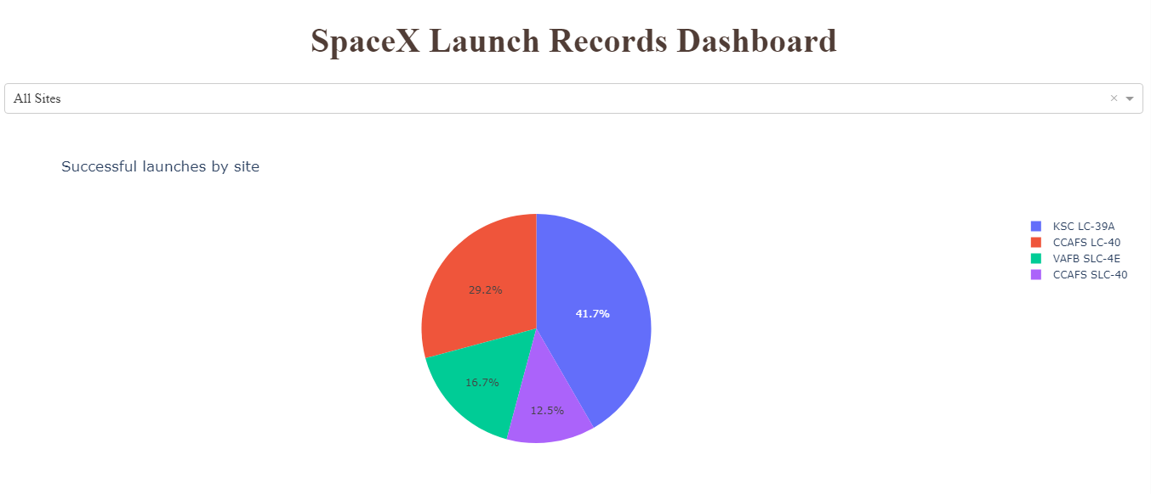
Total Successes by Launch site
We see here the homepage of the dashboard
The pie chart displays the percentage of successful launches broken down by launch site
Greatest proportion of successes attributed to KSC LC-39A
Lowest proportion attributed to CCAFS SLC-40

Slide 38
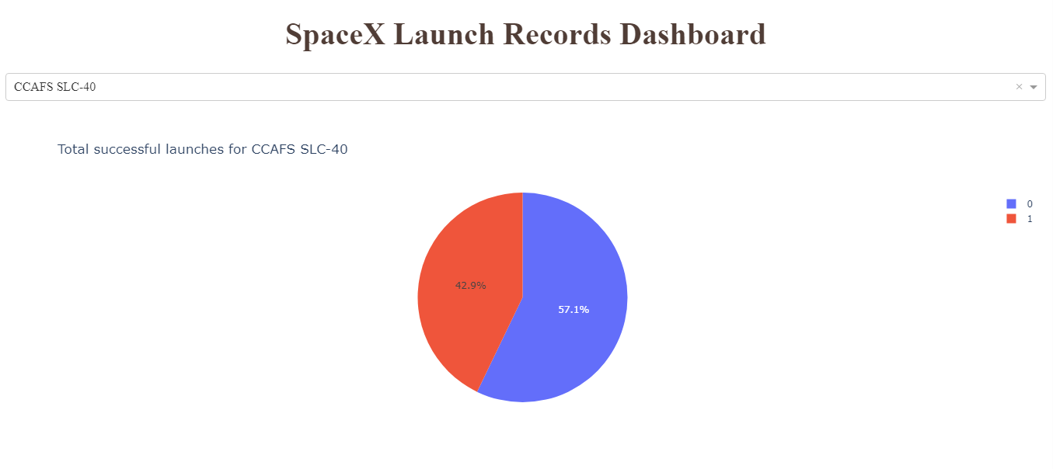
Most successful site
Despite making up the smallest number of successes, CCAFS SLC-40 has the highest success rate
Fewer launches at this site but they were on the whole more successful

Slide 39
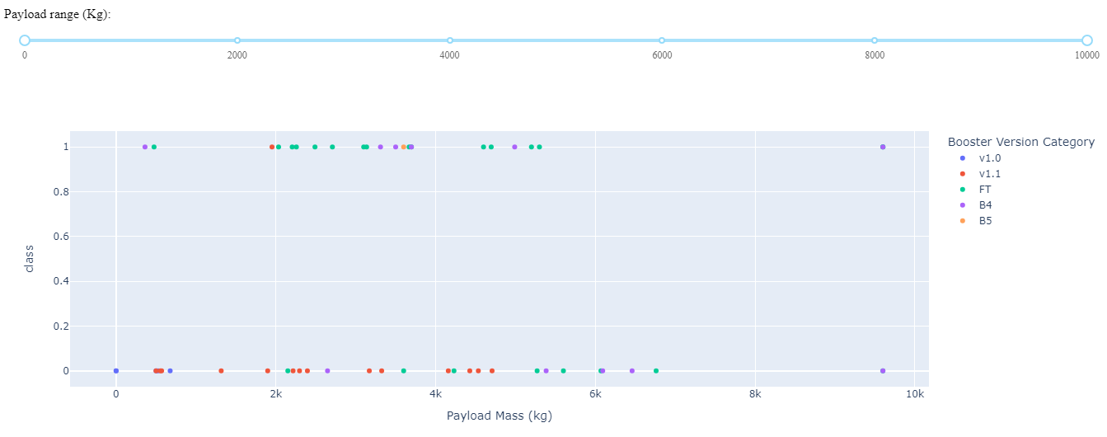
Payload Mass by Site, and success rate
Highest success rate is seen between masses of 2000 kg and 4000 kg
The most successful boosters appear to be FT and B4

Slide 40

Section 5

Slide 41
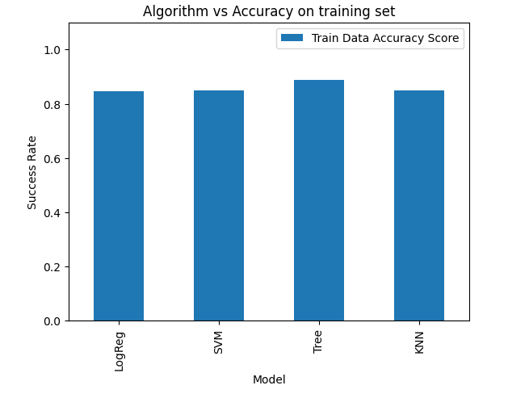
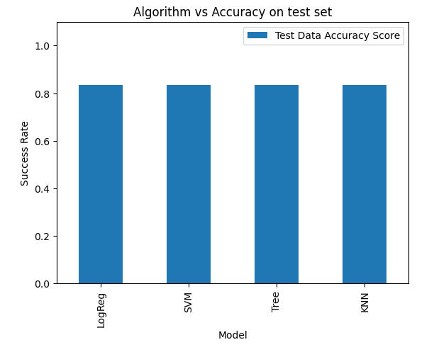
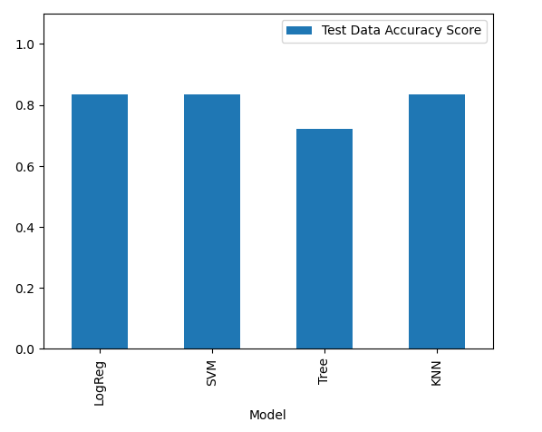
Classification Accuracy
We see that in the training data set the decision tree algorithm out-performs all others
However, when applied to the test set it falls flat
The overall best performance was produced by the KNN and SVM algorithms

Slide 42
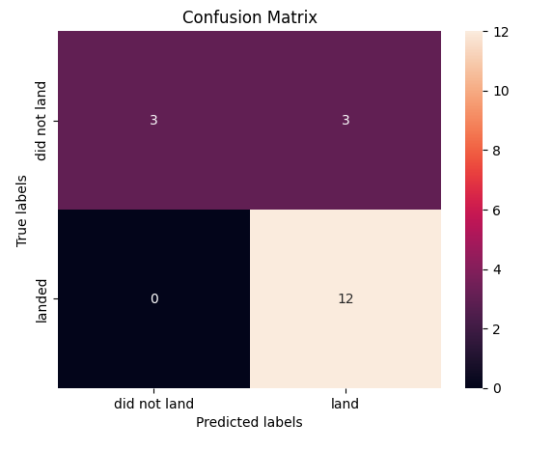
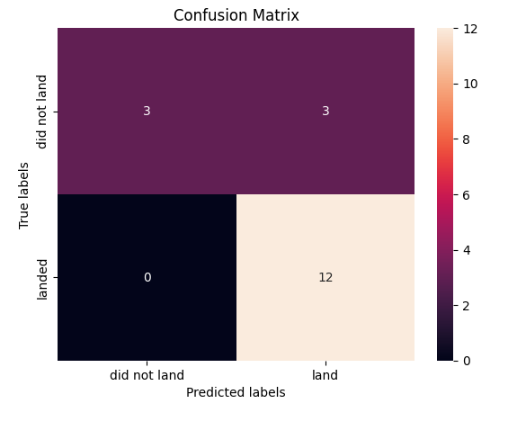
Confusion Matrix
We see the confusion matrices for the KNN and the SVM algorithms
Both perform identically, with both producing the best accuracy scores on training and test sets
We see no false negatives, but three false positives produced by both models
SVM
KNN

Slide 43
Conclusions
SpaceX saw a steady increase in successes until 2020
Payload masses are most successful between 2000 and 4000 kg. we should limit our launches to these masses until high success is achieved
The most successful site is CCAFS SLC-40, we should replicate their set-up and operations
The classification models broadly perform to a similar level, though SVM or KNN should be used for greatest accuracy

Slide 44


